Slide 1
SQL
Joins

Slide 2
So far…
We’ve only been executing queries against one table
Power of SQL comes from the fact we can run queries against multiple tables at once
This enables the term relational database – that is, tables can relate to one another
Joins are the statement we use to ‘connect’ the tables together

Slide 3
As a data scientist…
You probably won’t be building/creating databases from scratch
However, understanding why databases separate things into different tables is necessary
Different tables fundamentally store different types of objects (e.g. a customer object is not the same as a film object)
Allows for more efficient read/writes… Imagine if all information was stored in one table. When, for example, a customer changes their address, we now have to update every single row in this table where that customer placed the order.
Normalization

Slide 4
Film ID | Film Name | Rental Date | Customer ID | Customer Name | Customer Address
1 | Film 1 | 01/01/2020 | 1 | John | 3 Real Street
2 | Film 2 | 05/01/2020 | 1 | John | 3 Real Street
3 | Film 3 | 15/01/2020 | 2 | Bob | 7 Fake Road
4 | Film 4 | 25/01/2020 | 2 | Bob | 7 Fake Road
5 | Film 5 | 01/02/2020 | 1 | John | 3 Real Street
Have to change all these records
VS
Film ID | Film Name | Rental Date | Customer ID
1 | Film 1 | 01/01/2020 | 1
2 | Film 2 | 05/01/2020 | 1
3 | Film 3 | 15/01/2020 | 2
4 | Film 4 | 25/01/2020 | 2
5 | Film 5 | 01/02/2020 | 1
Customer ID | Customer Name | Customer Address
1 | John | 3 Real Street
2 | Bob | 7 Fake Road
Just change this one record

Slide 5
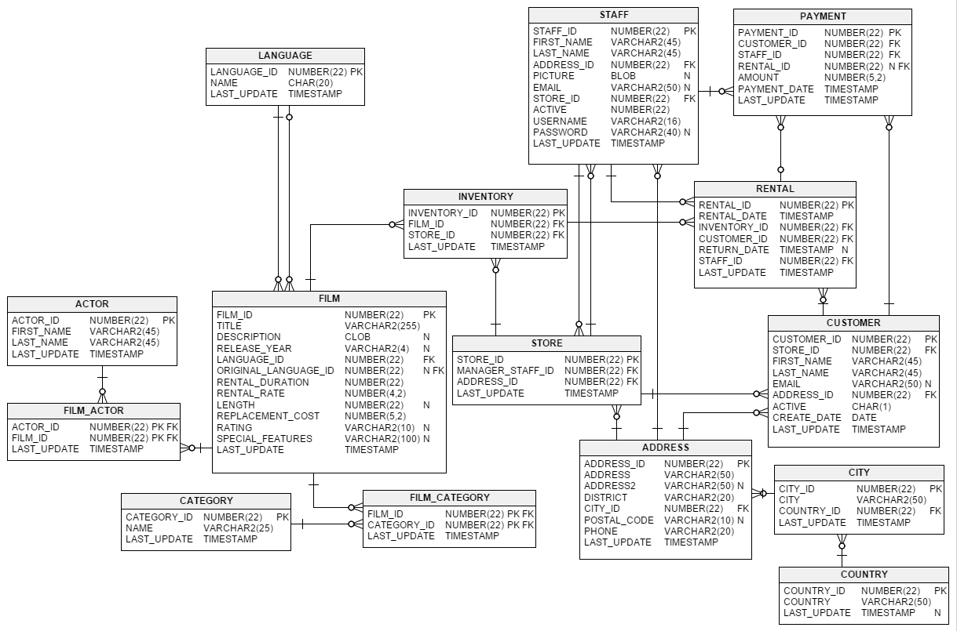
PK = Primary Key
FK = Foreign Key

Slide 6
Notice that each of the first columns in every table is a PK (generally an ID)
PKs are unique identifiers for entries in a table

Slide 7
A FK is a column in one table which is a PK in a different table
Many of this ID in this table
One of this ID in this table

Slide 8
FILM_ID is the FK
Linked to the FILM_ID PK in the FILM table
“Crows foot” indicates many of the instances of a FK can be present in the INVENTORY table
Dash line indicates only one instance of PK will be in the FILM table

Slide 9
Your first JOIN
Our SQL query contains the two tables we want to JOIN
One is placed after FROM
The other after JOIN
We use ON to link the PK of one of the tables to an FK of the other
SELECT * FROM staff JOIN address ON staff.address_id = address.address_id
SELECT staff.*, address.* FROM staff JOIN address ON staff.address_id = address.address_id

Slide 10
We can JOIN on more than one table
The same logic…
SELECT * FROM staff JOIN address ON staff.address_id = address.address_id JOIN city ON address.city_id = city.city_id

Slide 11
Challenges!
Find the addresses of all the stores
Return the first names, last names, addresses, districts and postal code for all the staff in the database
Return the first names, last names, addresses, districts and cities of customers who have rented a film
Return the first names, last names, addresses, districts and cities of customers who have rented a film between 26/05/2005 and 29/05/2005. Limit the results to 25 customers and sort the results by the last names in ascending order

Slide 12
Aliasing
Lots of things to type out in the last couple of challenges…
Aliasing allows us to create temporary variables which we can reference in our query
Typically we alias our tables as just the first letter of the table name
Similar to what we saw in the arithmetic stuff in the previous powerpoint… we use AS to alias
We can actually omit the AS, but it’s in this example for clarity
SELECT cu.first_name, cu.last_name, a.address, a.district, c.city FROM customer AS cu JOIN address AS a ON cu.address_id = a.address_id JOIN rental AS r ON r.customer_id = cu.customer_id JOIN city AS c ON a.city_id = c.city_id WHERE r.rental_date BETWEEN '2005-05-26' AND '2005-05-29'

Slide 13
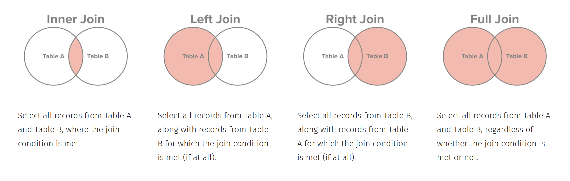
Other types of JOINs
So far, we’ve looked at inner JOINs. There are also LEFT JOINs, RIGHT JOINs, and FULL JOINs
Source: http://www.sql-join.com/sql-join-types

Slide 14
LEFT JOIN
We now have a concept of a left table and right table
Left table is the table immediately following FROM
Right table is the table immediately following LEFT JOIN
A LEFT JOIN selects all from the left table, and matches every row in this table to the row in the right table (based on the ON condition)
When the join condition is true, columns from both tables are combined and added to the table to be returned
This part is an INNER JOIN
If/when the join condition is false, a new row is still added to the returned table – however, values are NULLed for the columns of the right table

Slide 15
SELECT *
FROM address a
LEFT JOIN customer c
ON a.address_id = c.address_id
WHERE c.customer_id is NULL
This LEFT JOIN returns all addresses including those which don’t have a customer associated with them. If an address has no customer associated, the returned columns from customer are NULL
Left table
Right table
Join condition

Slide 16
RIGHT JOINs?
RIGHT JOINs act similarly to LEFT JOINs, but now the returned table will have all the rows from the right table (and the relevant values NULLed in the return table)
RIGHT JOINs can be written as LEFT JOINs
Just need to switch the tables that are in the FROM and JOIN statements
Convention is to use LEFT JOINs… let’s stick with it
Notice that LEFT and RIGHT JOINs always return the same data as an INNER JOIN. And then potentially some more rows.

Slide 17
OUTER JOIN
Rare use case
Returns the results of an INNER JOIN as well as unmatched rows on either side of the two tables
Won’t cover it here – but view this link if you’re interested in learning it: http://www.w3resource.com/sql/joins/perform-a-full-outer-join.php
Discussion about its uses: https://stackoverflow.com/questions/2094793/when-is-a-good-situation-to-use-a-full-outer-join

Slide 18
Challenges!
You are given these two tables:
customerID | customerName
1 | Homer
2 | Marge
3 | Bart
4 | Lisa
5 | Maggie
6 | Moe
orderID | customerID | item
1 | 1 | Beer
2 | 2 | Hair product
3 | 2 | Dress
4 | 3 | Juice
5 | 3 | Magazine
6 | 6 | Peanuts

Slide 19
Challenges!
Given the following SQL statement, answer:
Number of columns in returned table
Number of rows in returned table
Number of times customerID “2” would show up
Number of times customerID “5” would show up
Given the following SQL statement, answer:
Number of columns in returned table
Number of rows in returned table
Number of times customerID “2” would show up
Number of times customerID “5” would show up
SELECT c.customerID, c.customerName, o.item FROM customer c JOIN order o ON c.customerID = o.customerID
SELECT c.customerID, c.customerName, o.item FROM customer c LEFT JOIN order o ON c.customerID = o.customerID

